Slide 1
Inheritance

Slide 2
Single Inheritance
A class can be derived from a single base class is called single inheritance
Person
Employee

Slide 3
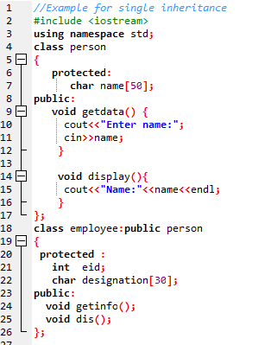

Slide 4
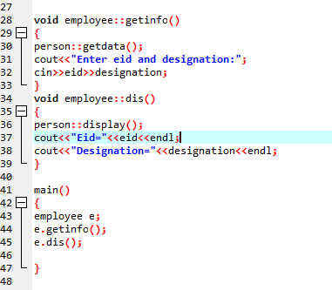

Slide 5
Multilevel Inheritance
A class be can derived from a derived class which is known as multilevel inheritance.
Vehicle
Person
Car
Employee
Racing car
Part time Employee

Slide 6
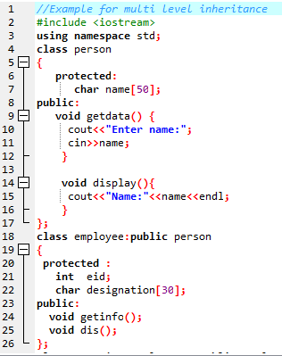

Slide 7
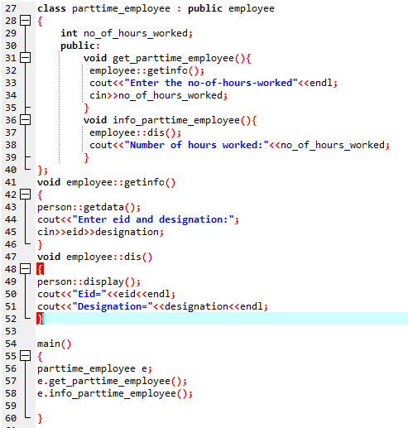

Slide 8
Multiple Inheritance
It is the process of creating new class from more than one base classes.
Syntax :
class <derived class >:<access specifier>
base_class1,<access specifier> base_class2...
{
private :
// members;
protected :
// members;
public :
//memebers;
};
Person
Employee
Teacher

Slide 9
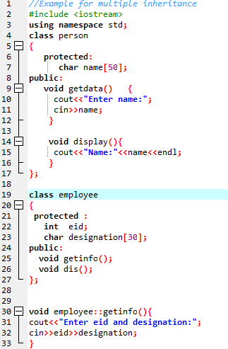

Slide 10
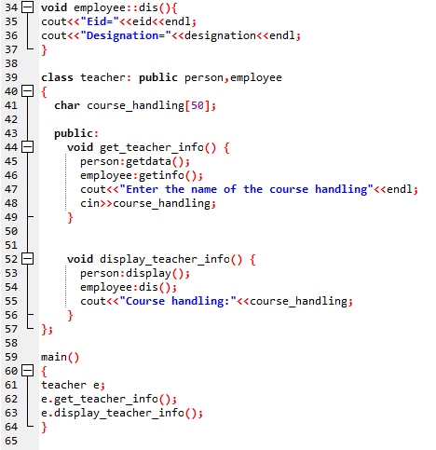

Slide 11
Inheritance Constructor and Destructor call order
#include <iostream> // std::cout
// for more tutorials visit www.ProDeveloperTutorial.com
using namespace std;
class Base
{
public:
Base()
{
cout<<"Constructor Base \n";
}
~Base()
{
cout<<"Destructor Base \n";
}
};
class Derived: public Base
{
public:
Derived()
{
cout<<"Constructor Derived \n";
}
~Derived()
{
cout<<"Destructor Derived \n";
}
};
int main(void)
{
Derived d;
return 0;
}

Slide 12
Inheritance Constructor call order
#include<iostream>
using namespace std;
class A // Base class
{
public:
A()
{
cout << "Base class A constructor \n";
}
};
class B: public A // Derived class B
{
public:
B()
{
cout << "Class B constructor \n";
}
};
// Derived class C
class C: public B
{
public:
C()
{
cout << "Class C constructor \n";
}
};
// Driver code
int main()
{
C obj;
return 0;
}

